Slide 1

BREAKING LANGUAGE BARRIERS: FINE-TUNING WHISPER FOR
BENGALI AND TELUGU AUTOMATIC SPEECH RECOGNITION
Human-Centered Natural Language Processing
Imon Kalyan Ghosh
Veera Raghavulu Bathula
Ishmita Basu

Slide 2
BREAKING LANGUAGE BARRIERS: FINE-TUNING WHISPER FOR
BENGALI AND TELUGU AUTOMATIC SPEECH RECOGNITION
AGENDA
Motivation
Keywords
Introduction
Whisper Architecture
PEFT Methods
Process Flow
Implementation
Results & Analysis
Demo
Challenges
Conclusion
Future Scope
Notes:
‹#›

Slide 3
BREAKING LANGUAGE BARRIERS: FINE-TUNING WHISPER FOR
BENGALI AND TELUGU AUTOMATIC SPEECH RECOGNITION
MOTIVATION
Whisper struggles with low-resource languages like Bengali and Telugu
Indic languages lack Automatic Speech Recognition support despite growing voice tech demand
Fine-tuning Whisper boosts performance on specific low-resource languages
Enables inclusive speech tech through curated language-specific datasets
Notes:
‹#›

Slide 4

BREAKING LANGUAGE BARRIERS: FINE-TUNING WHISPER FOR
BENGALI AND TELUGU AUTOMATIC SPEECH RECOGNITION
KEYWORDS
AUTOMATIC SPEECH RECOGNITION (ASR) – converts spoken language into written text using algorithms that analyse and interpret audio signals
PARAMETER EFFICIENT FINE TUNING (PEFT) – a technique that adapts large models to new tasks by training only a small subset of parameters, while keeping most of the pre-trained weights frozen
WORD ERROR RATE (WER) – used to evaluate the performance of ASR systems. It measures the percentage of words that were incorrectly predicted by comparing the transcribed output with a reference (ground truth) transcription
S (Substitutions): Number of words that were incorrectly transcribed.
D (Deletions): Number of missing words in the predicted transcript that were present in the reference.
I (Insertions): Number of extra words in the predicted transcript that were not in the reference.
N (Reference words): Total number of words in the reference transcript.
SOURCE : https://www.chatgpt.com

Slide 5
BREAKING LANGUAGE BARRIERS: FINE-TUNING WHISPER FOR
BENGALI AND TELUGU AUTOMATIC SPEECH RECOGNITION
INTRODUCTION
ASR progress has largely excluded low-resource languages like Bengali and Telugu due to limited annotated data
PEFT methods—LoRA, Adapter Layers and BitFit along with SpecAugment data augmentation—were used to fine-tune Whisper for these languages with fewer trainable parameters.
Experiments showed reduced WER and improved ASR performance in both languages using limited resources
A streamlined training pipeline was built to make low-resource ASR research more accessible and scalable
Notes:
‹#›

Slide 6
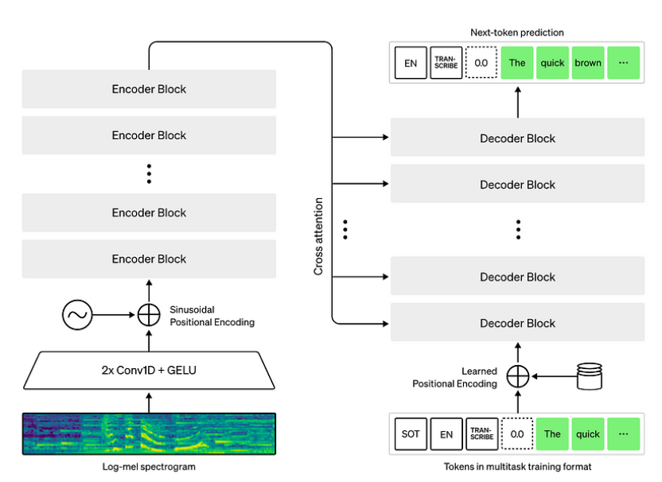
BREAKING LANGUAGE BARRIERS: FINE-TUNING WHISPER FOR
BENGALI AND TELUGU AUTOMATIC SPEECH RECOGNITION
WHISPER ARCHITECTURE
SOURCE : https://www.louisbouchard.ai/whisper/

Slide 7
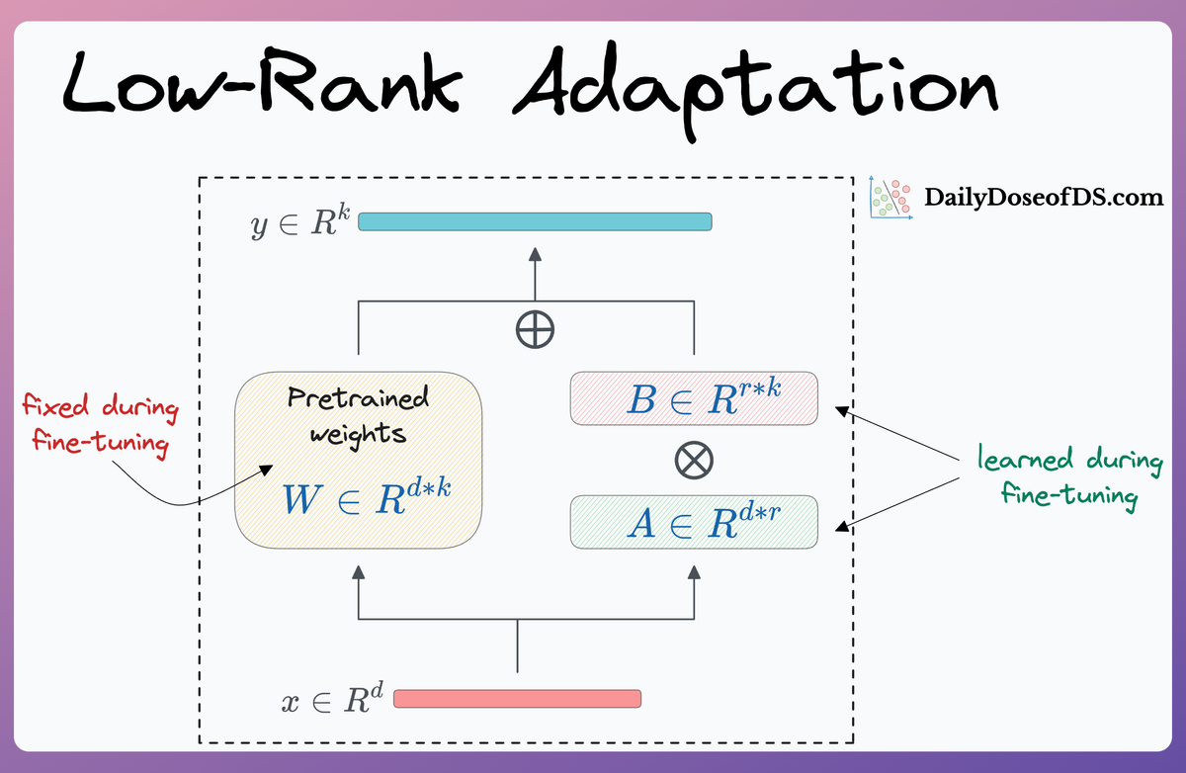
BREAKING LANGUAGE BARRIERS: FINE-TUNING WHISPER FOR
BENGALI AND TELUGU AUTOMATIC SPEECH RECOGNITION
PEFT METHODS
LoRA Method Architecture
SOURCE : https://www.dailydoseofds.com/understanding-lora-derived-techniques-for-optimal-llm-fine-tuning/
Notes:
‹#›

Slide 8
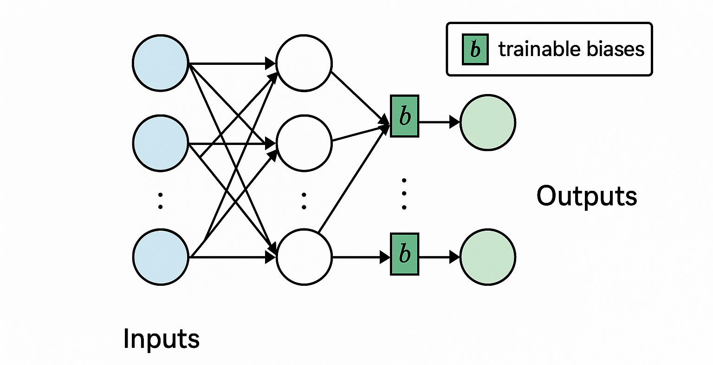
BREAKING LANGUAGE BARRIERS: FINE-TUNING WHISPER FOR
BENGALI AND TELUGU AUTOMATIC SPEECH RECOGNITION
PEFT METHODS
BitFit Method Architecture
SOURCE : https://chatgpt.com/g/g-p-67cf1b5d2ecc819193e652dc248d300b-hcnlp/project
Notes:
‹#›

Slide 9
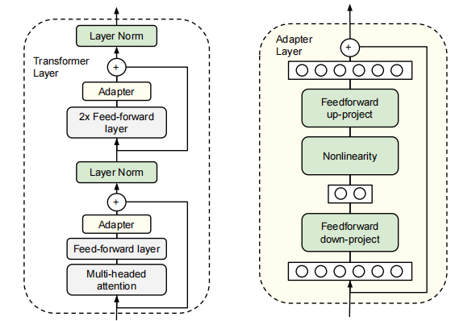
BREAKING LANGUAGE BARRIERS: FINE-TUNING WHISPER FOR
BENGALI AND TELUGU AUTOMATIC SPEECH RECOGNITION
PEFT METHODS
Adapter Layers Architecture
SOURCE : Parameter-Efficient Transfer Learning for NLP
Notes:
‹#›

Slide 10
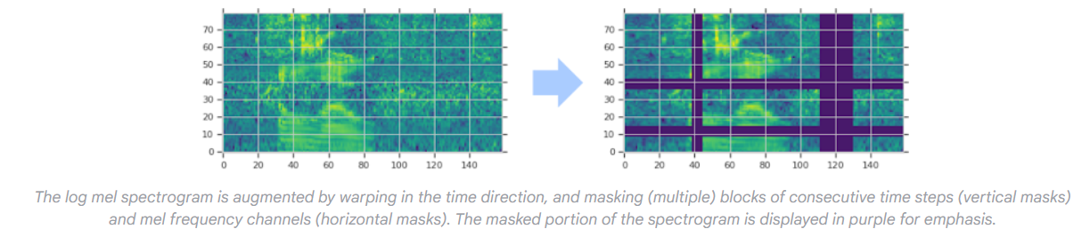
BREAKING LANGUAGE BARRIERS: FINE-TUNING WHISPER FOR
BENGALI AND TELUGU AUTOMATIC SPEECH RECOGNITION
SpecAugment Method Architecture
SOURCE : https://research.google/blog/specaugment-a-new-data-augmentation-method-for-automatic-speech-recognition/
Notes:
‹#›

Slide 11
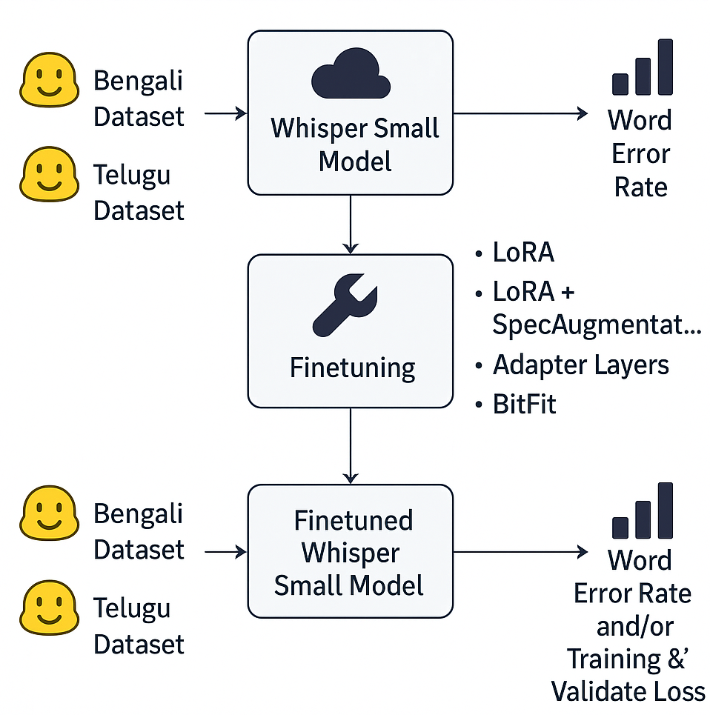
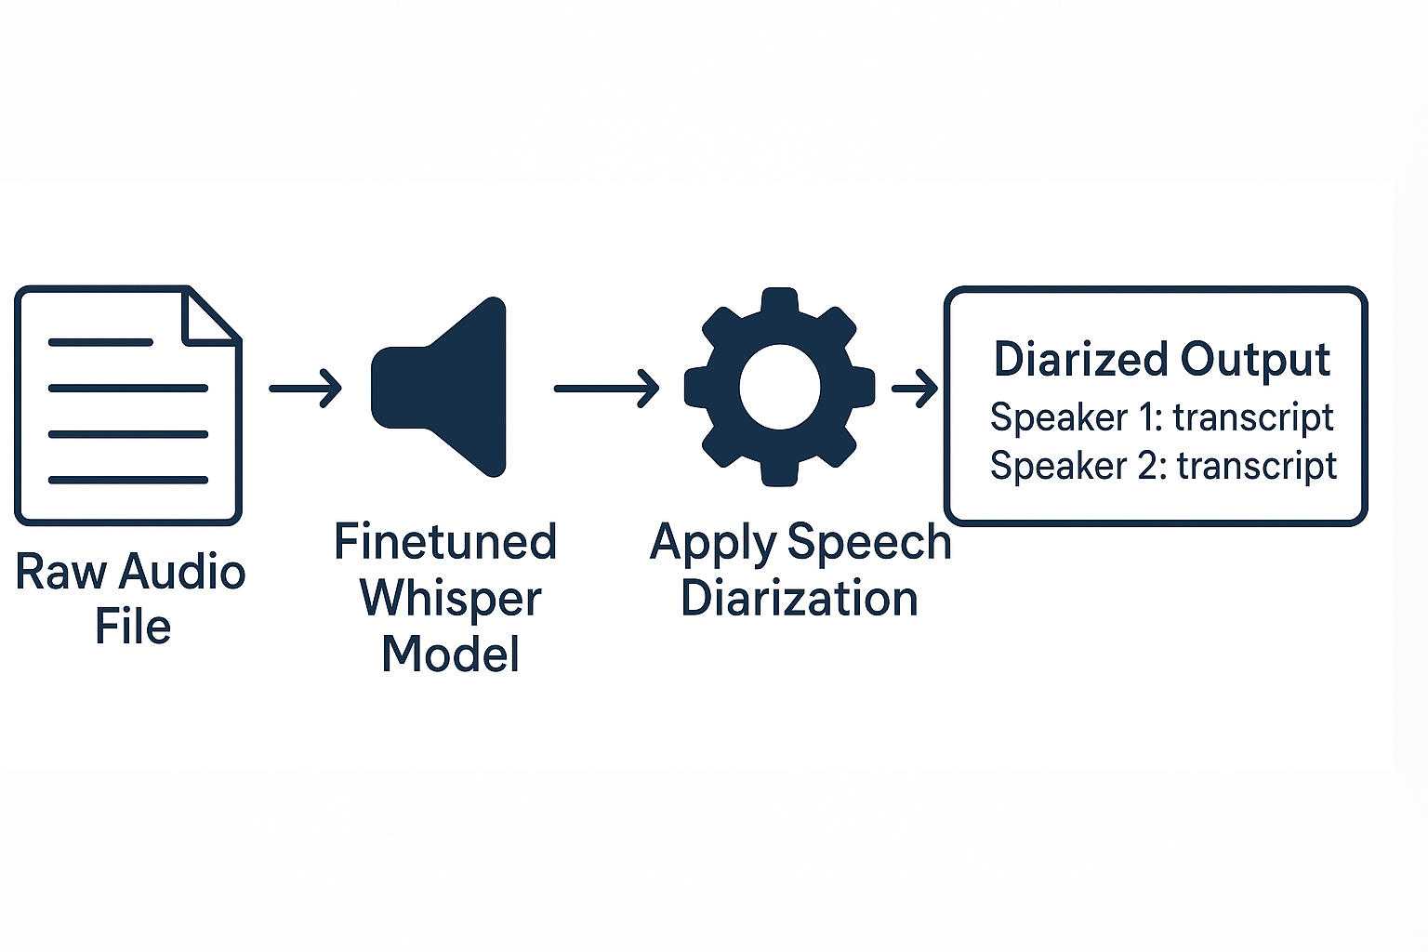
BREAKING LANGUAGE BARRIERS: FINE-TUNING WHISPER FOR
BENGALI AND TELUGU AUTOMATIC SPEECH RECOGNITION
PROCESS FLOW
Research Process Flow
Speech Diarization
Notes:
‹#›

Slide 12
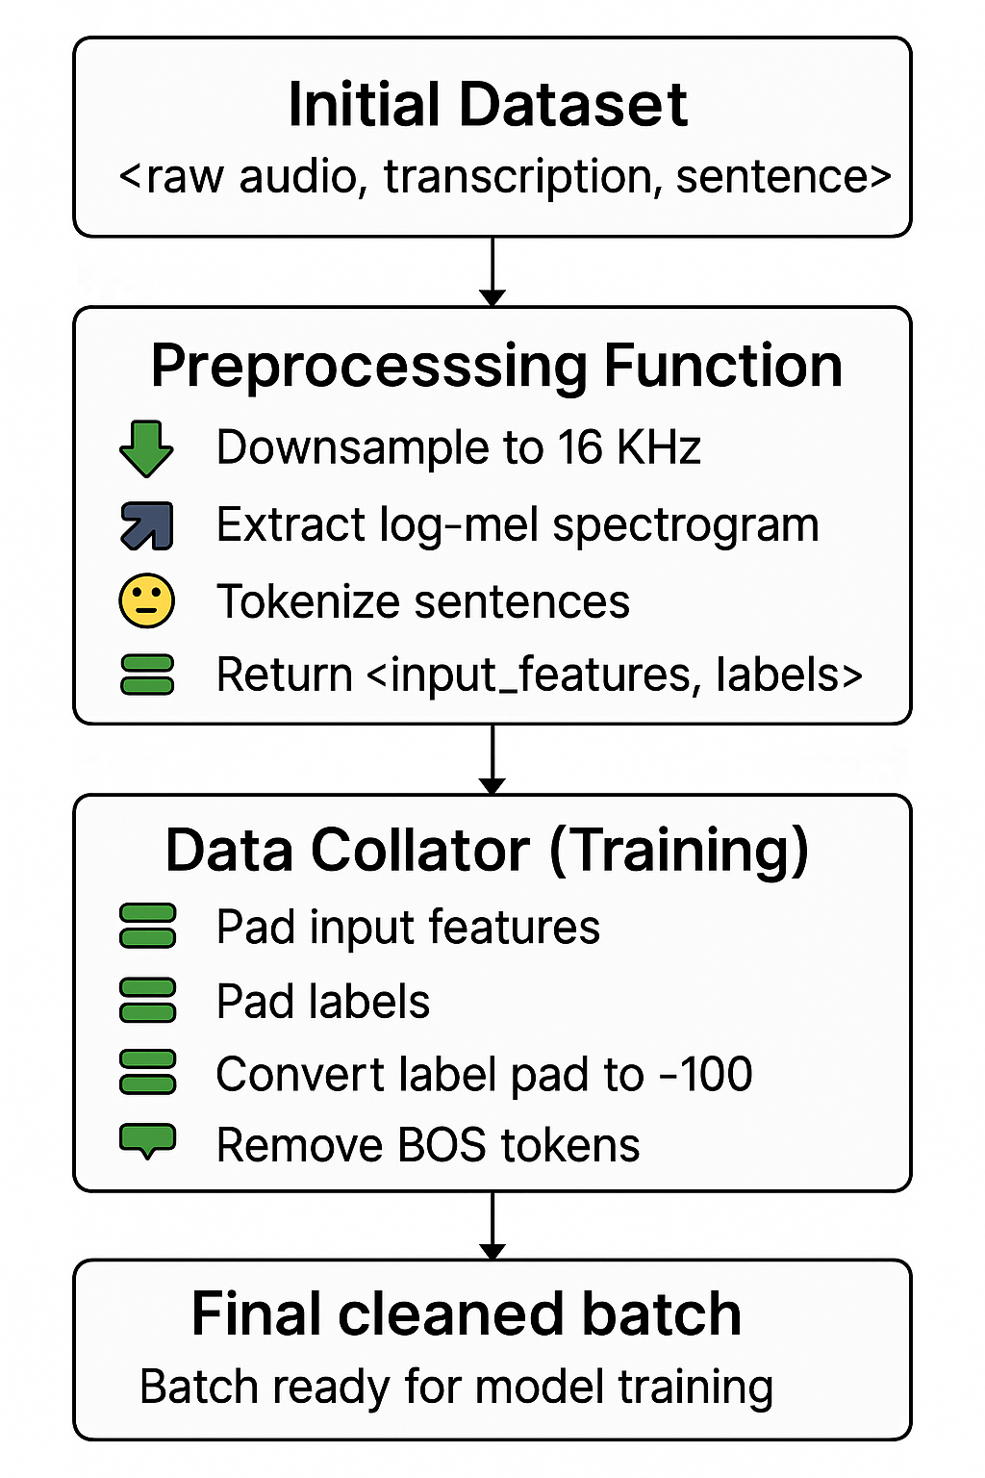
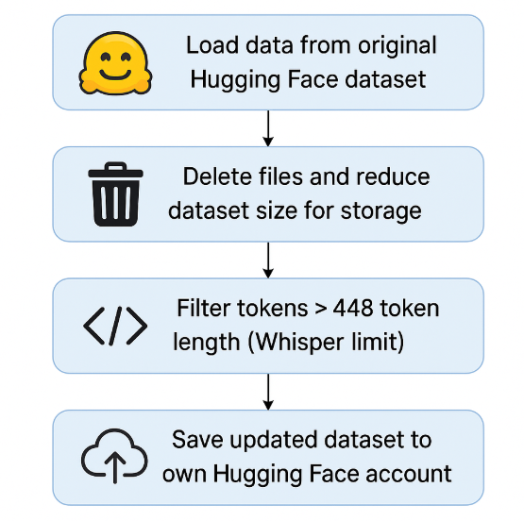
BREAKING LANGUAGE BARRIERS: FINE-TUNING WHISPER FOR
BENGALI AND TELUGU AUTOMATIC SPEECH RECOGNITION
IMPLEMENTATION
Data Preparation
Data Preprocessing
Notes:
‹#›

Slide 13
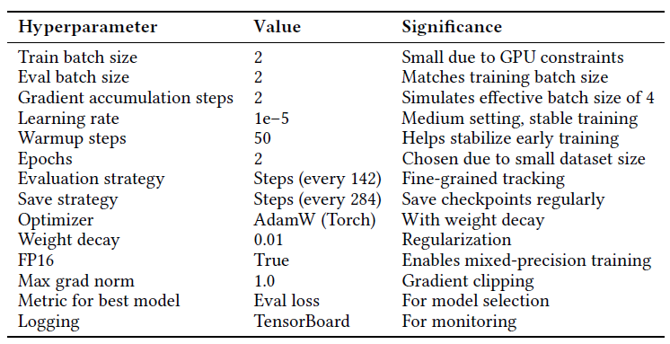
BREAKING LANGUAGE BARRIERS: FINE-TUNING WHISPER FOR
BENGALI AND TELUGU AUTOMATIC SPEECH RECOGNITION
IMPLEMENTATION
Hyperparameter Selection
Notes:
‹#›

Slide 14
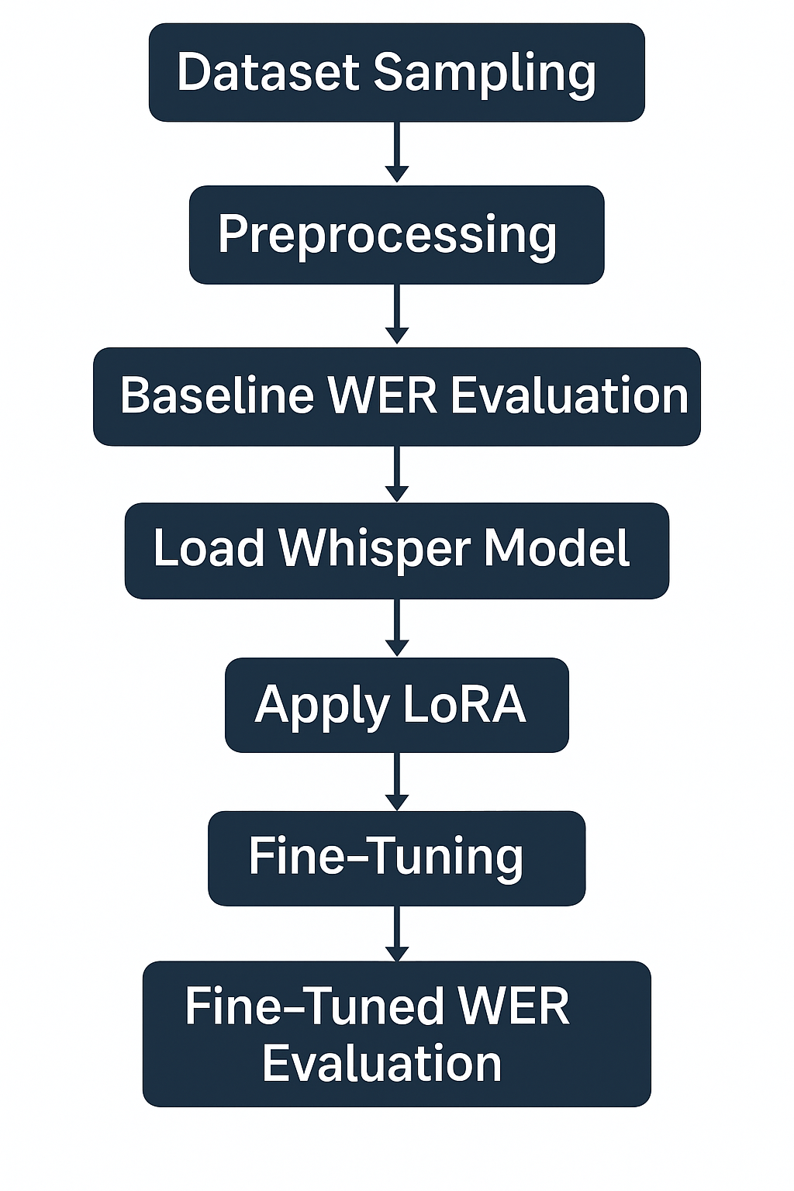
BREAKING LANGUAGE BARRIERS: FINE-TUNING WHISPER FOR
BENGALI AND TELUGU AUTOMATIC SPEECH RECOGNITION
IMPLEMENTATION
Pipeline
CLI Command
Save Model to Hugging Face
Notes:
‹#›

Slide 15
BREAKING LANGUAGE BARRIERS: FINE-TUNING WHISPER FOR
BENGALI AND TELUGU AUTOMATIC SPEECH RECOGNITION
IMPLEMENTATION
Methodology
LoRA: Fine-tuned only the attention projection layers using low-rank adaptation (rank matrices(r)=32, scaling factor(α)=64, dropout=0.05) freezing all other parameters to enable efficient ASR adaptation
BitFit: Enabled training solely on bias parameters by freezing all other model weights
Adapter Layers: Inserted lightweight adapter modules (64-dim bottleneck with GELU and residuals) into each transformer block, training only the adapter parameters while keeping the Whisper model frozen
LoRA with SpecAugment: Enhanced LoRA fine-tuning by applying SpecAugment on training data (random time and frequency masking)
Notes:
‹#›

Slide 16
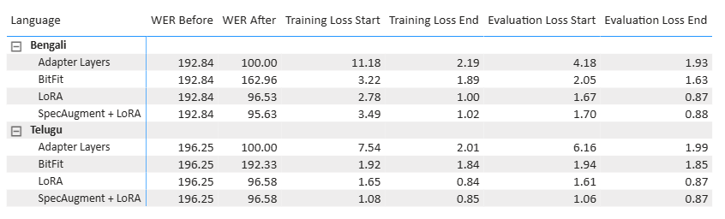
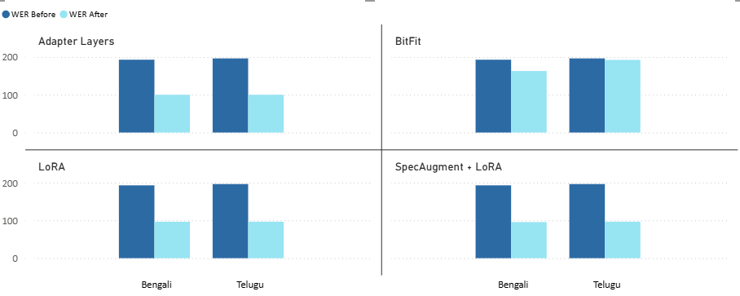
BREAKING LANGUAGE BARRIERS: FINE-TUNING WHISPER FOR
BENGALI AND TELUGU AUTOMATIC SPEECH RECOGNITION
RESULTS & ANALYSIS
Results & WER Analysis
Notes:
‹#›

Slide 17
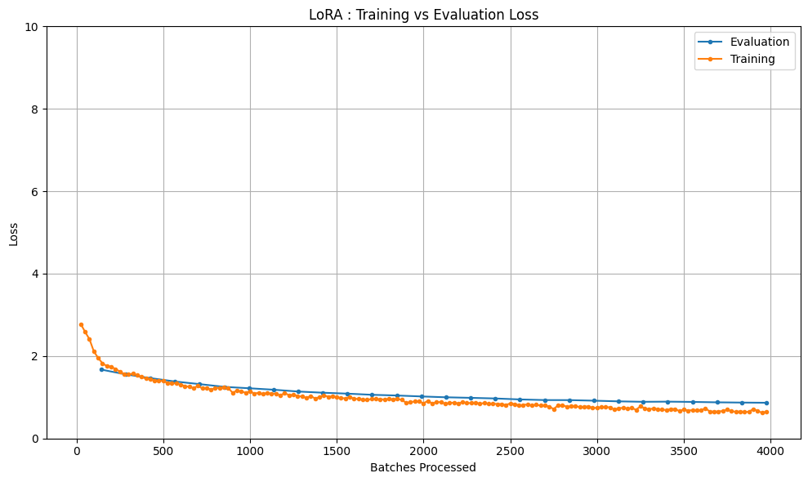
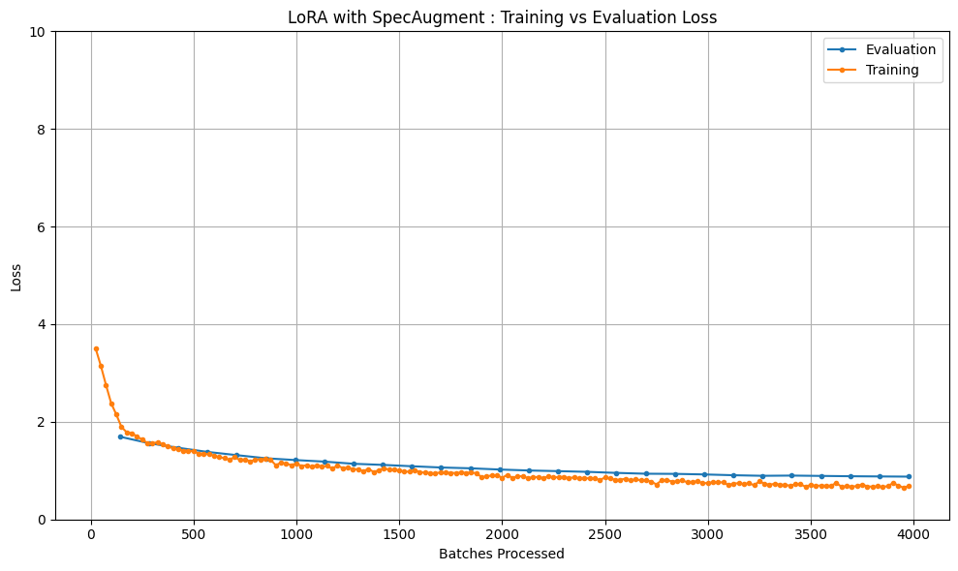
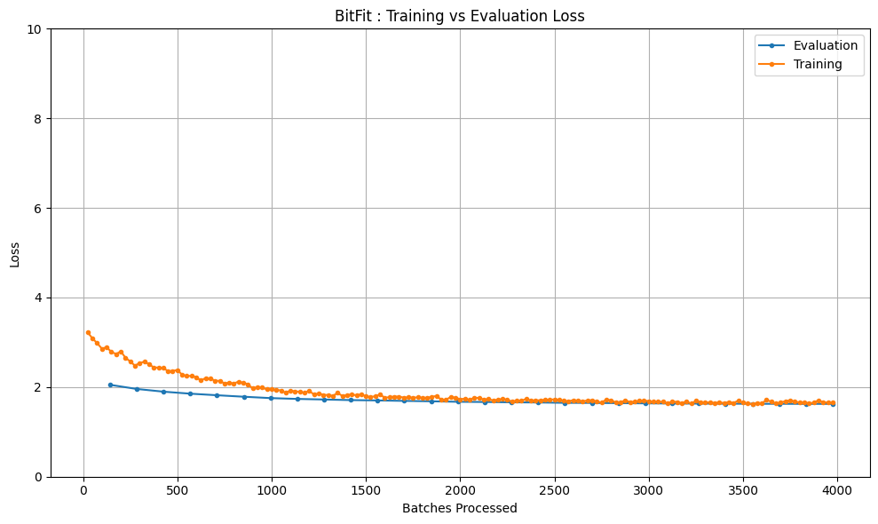
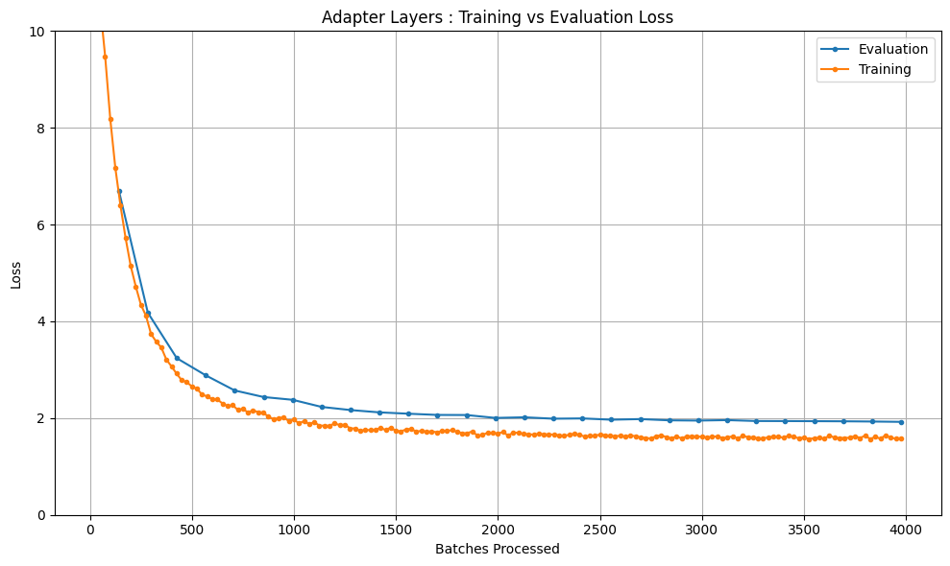
BREAKING LANGUAGE BARRIERS: FINE-TUNING WHISPER FOR
BENGALI AND TELUGU AUTOMATIC SPEECH RECOGNITION
RESULTS & ANALYSIS
Training vs Evaluation Loss Analysis
Notes:
‹#›

Slide 18
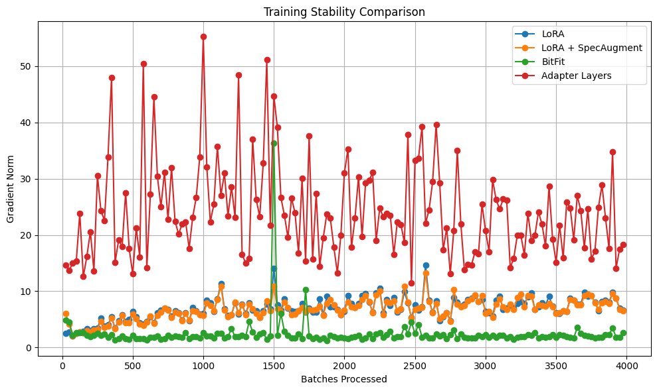
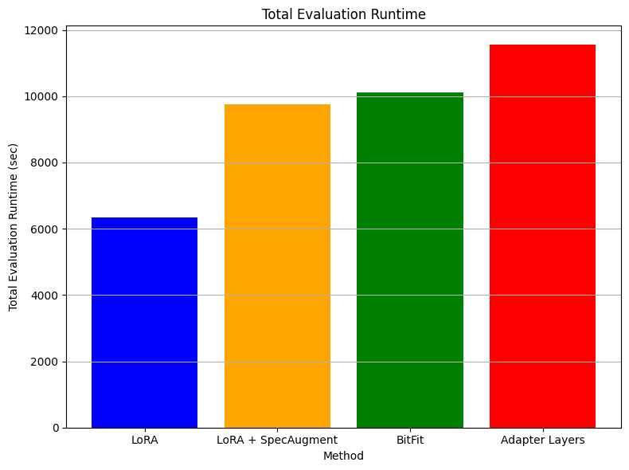
BREAKING LANGUAGE BARRIERS: FINE-TUNING WHISPER FOR
BENGALI AND TELUGU AUTOMATIC SPEECH RECOGNITION
RESULTS & ANALYSIS
Training Stability and Evaluation Runtime Analysis
Notes:
‹#›

Slide 19

BREAKING LANGUAGE BARRIERS: FINE-TUNING WHISPER FOR
BENGALI AND TELUGU AUTOMATIC SPEECH RECOGNITION
GitHub Repo : Code Link
Output : Document for Output
Notes:
‹#›

Slide 20
BREAKING LANGUAGE BARRIERS: FINE-TUNING WHISPER FOR
BENGALI AND TELUGU AUTOMATIC SPEECH RECOGNITION
CHALLENGES
Dataset Availability for low resource languages on Hugging Face
Data Preparation Complexity
Prefix Tuning Compatibility
Speech Diarization
Dialectal Variation
Adapter Layer Underperformance
Notes:
‹#›

Slide 21
BREAKING LANGUAGE BARRIERS: FINE-TUNING WHISPER FOR
BENGALI AND TELUGU AUTOMATIC SPEECH RECOGNITION
CONCLUSION
Evaluated LoRA, SpecAugment + LoRA, BitFit, and Adapter Layers on Whisper-small for Bengali and Telugu ASR
LoRA offered the best balance of WER reduction, stability, and efficiency—fine-tuning <3% of parameters
SpecAugment gave slight WER gains for Bengali but added evaluation overhead and was dataset-size dependent
BitFit showed limited improvement due to its low parameter update capacity.
Adapter Layers were affected by unstable training dynamics, leading to poor performance.
Notes:
‹#›

Slide 22
BREAKING LANGUAGE BARRIERS: FINE-TUNING WHISPER FOR
BENGALI AND TELUGU AUTOMATIC SPEECH RECOGNITION
FUTURE SCOPE
Integrate speaker diarisation using tools like PyAnnote and timestamped Whisper models (Whisperx, faster-whisper) for accurate multi-speaker transcription
Build a web-based UI to support audio upload, feature toggles (e.g., diarisation), and easy transcript access
Expand to dialectal ASR via crowdsourced datasets for better coverage of regional variants
Explore real-time, cross-lingual, and multimodal ASR capabilities to enhance transcription flexibility and context awareness
Source - PyAnnote : https://pypi.org/project/pyannote.audio/2.1.1/ WhisperX: https://pypi.org/project/whisperx/3.1.1/ Faster Whisper: https://pypi.org/project/faster-whisper/0.3.0/
Notes:
‹#›

Slide 23
‹#›
BREAKING LANGUAGE BARRIERS: FINE-TUNING WHISPER FOR
BENGALI AND TELUGU AUTOMATIC SPEECH RECOGNITION
Thank you!

